Slide 1
Real Estate DBMS Project
CS241
Deliverable 1
Name : Thirumurugan R
Roll no : 1801185
Section : CG 2

Slide 2
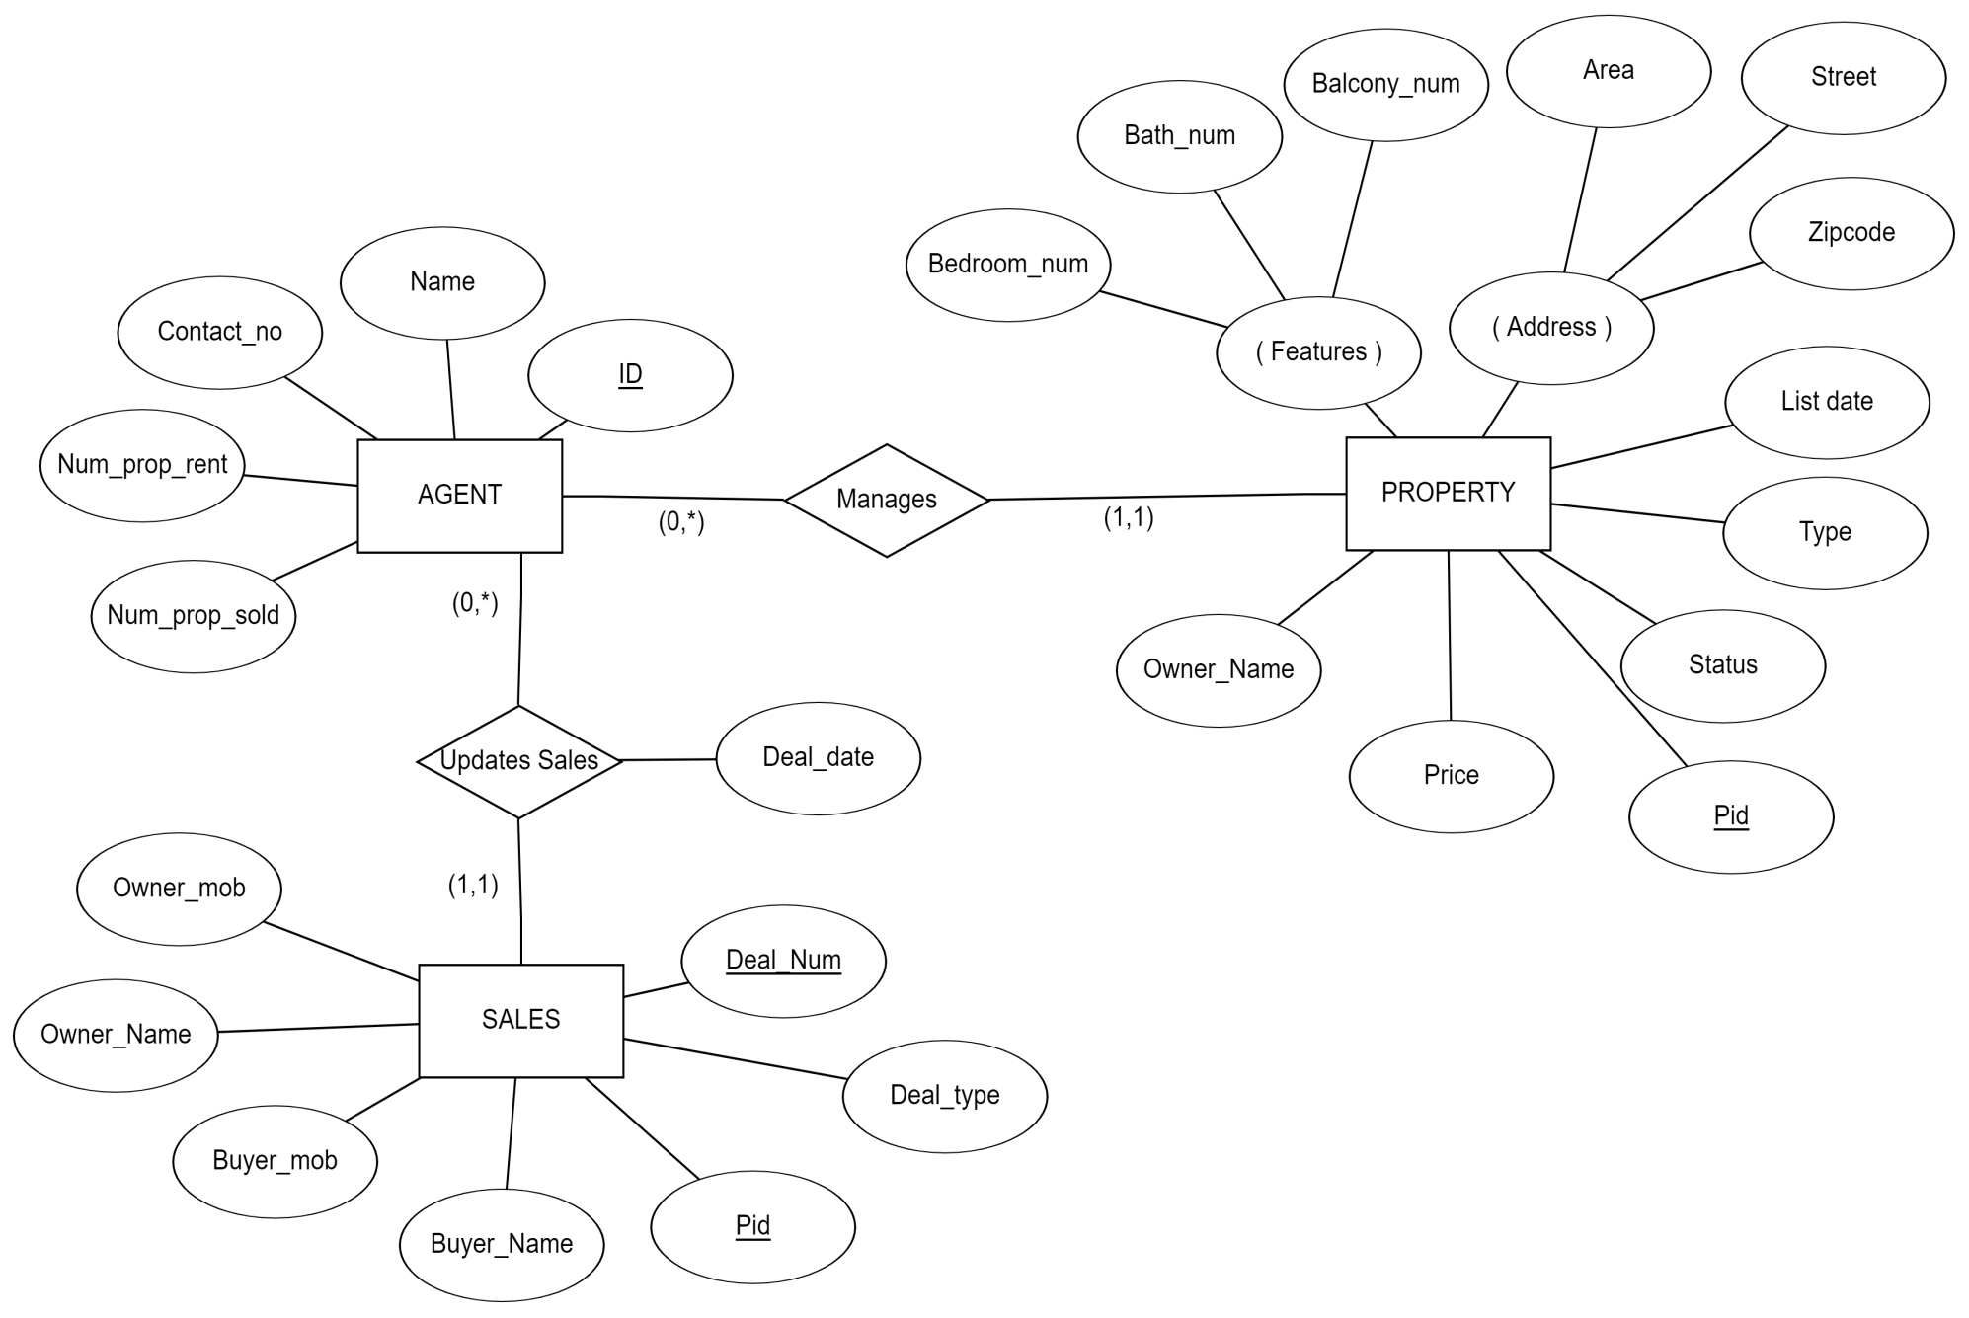
ER DIAGRAM
Assumptions:
Every Property must be associated with an Agent.
Sales is updated only when a successful deal is made.
A property can be either ‘For Rent’ or ‘For Sale’ ,not both.

Slide 3
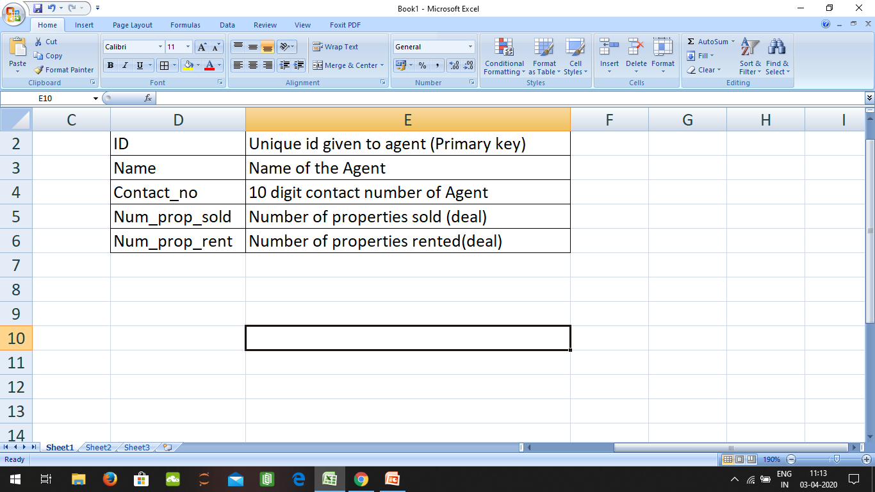
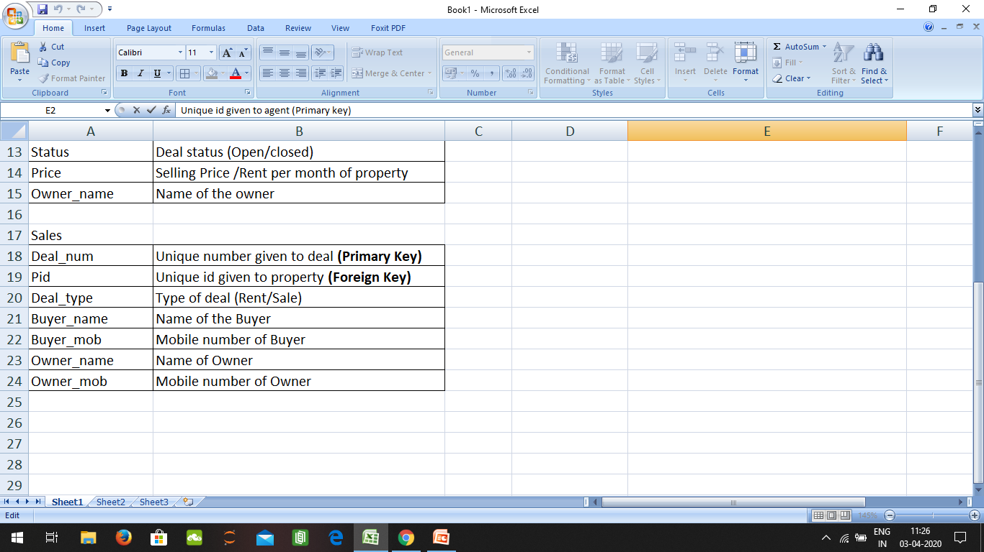
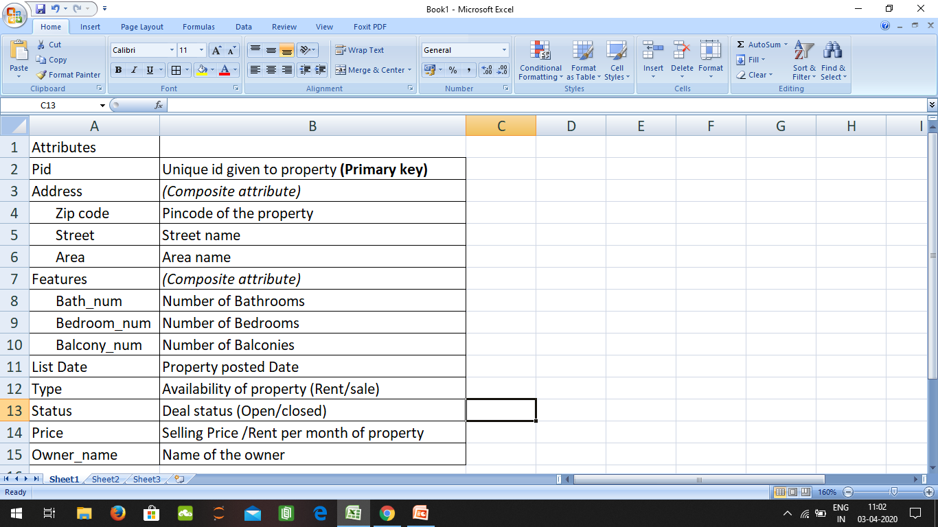
Entities and Attributes:
Sales
AGENT
PROPERTY
Relationships
Manages : Agent Manages property. He can add or remove property from Database when required .
Updates Sales : Agent Updates Sales , when a successful deal is made with buyer.
Contains Attribute :
Deal_date : Date when deal is made

